Slide 1


Pierdomenico Fiadino <fiadino@ftw.at>
The Telecommunications Research Center Vienna (ftw.)
Detection of Network Traffic Anomalies in
Content Delivery Networks
P. Fiadino, A. D’Alconzo, P. Casas, A. Bär (FTW), A. Finamore (Politecnico di Torino)

Slide 2

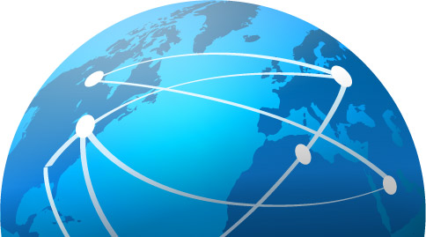




Motivations [1/2] Today’s Internet overview
Internet: different technologies are combined to offer a plethora of services
HTTP is the dominating content delivery protocol → 75% of the volume consumed by residential customers.
Today: large-scale web apps and Content Delivery Networks (CDNs)
CDNs account for more than 60% of HTTP traffic
Internet content (YouTube, Facebook, Apple Store) is largely delivered by major CDNs like Akamai and Google CDN.

Slide 3
Motivations [2/2] CDN complexity
CDN perform load-balancing among multiple servers (FEs, content replica)
CDNs policies have:
impacts on traffic routed by underlying transport network
influences on achieved latency/throughput (end-user’s QoE)
Complex and undisclosed time/space variant policies
Understanding CDN traffic patterns is challenging
for ISP and researchers
It’s important for ISPs to rapidly and automatically detect the occurrence of macroscopic changes in how CDNs serve traffic...
…especially when ISPs themselves and their users are negatively affected (i.e. anomalies)

Slide 4
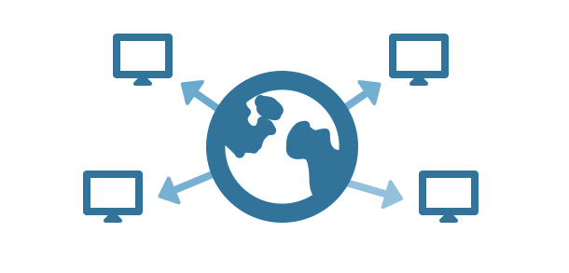
Outlook
Motivations
Monitoring setup and datasets
ADTool: an online Anomaly Detection tool
algorithm details
Use case 1: Akamai traffic shifts
Use case 2: Facebook outages
Use case 3: Youtube degradation of performances
Conclusions and Future Work

Slide 5
Outlook
Motivations
Monitoring setup and datasets
ADTool: an online Anomaly Detection tool
algorithm details
Use case 1: Akamai traffic shifts
Use case 2: Facebook outages
Use case 3: Youtube degradation of performances
Conclusions and Future Work

Slide 6

Monitoring and analysis setup
Dataset1 passively collected via Metawin at the Gn link of a Nation-wide mobile (3G) European Operator, over 30 days in 2013, millions of users
Dataset2 passively collected via Tstat at a fixed-line (DSL) link belonging to a nation-wide European Operator, over 40 days in 2013, thousands of users
DBStream (a smart streaming data warehouse) used to compute traffic distributions on the fly
ADTool implements a statistical Anomaly Detection (AD) algorithm to recognize macroscopic events, i.e. deviations in distribution of traffic features across Autonomous Systems, subnets, or users IP addresses
Internet
ISP
network
results
ADTool
Passive probe
network traces
DBStream
traffic distributions
aggregations

Slide 7
Outlook
Motivations
Monitoring setup and datasets
ADTool: an online Anomaly Detection tool
algorithm details
Use case 1: Akamai traffic shifts
Use case 2: Facebook outages
Use case 3: Youtube degradation of performances
Conclusions and Future Work

Slide 8
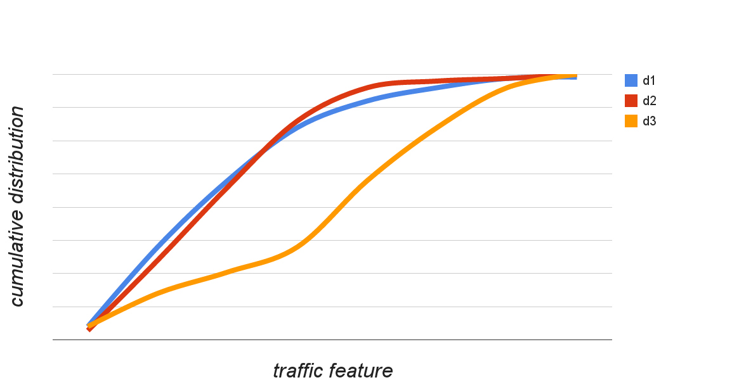
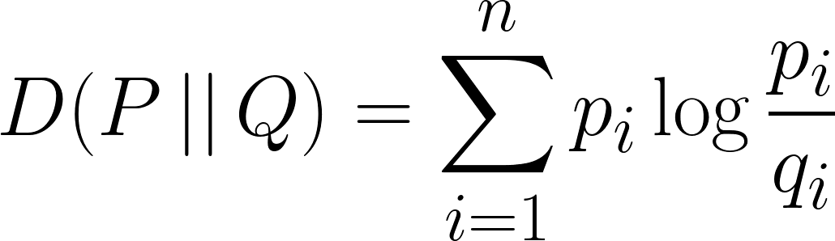
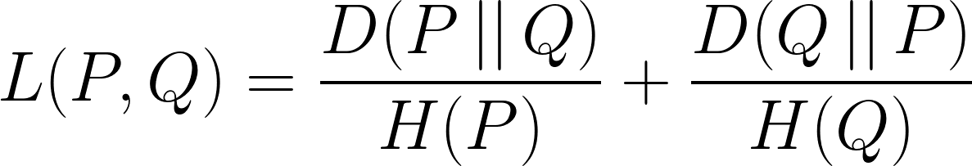
ADTool A statistical Anomaly Detection (AD) Tool
AD algorithm consists of two phases for each iteration (time batch):
Reference-Set identification: find past traffic distributions which are a suitable reference of normality (sliding window)
AD test: use a normalized variant of the Kullback-Leibler divergence to decide if current distribution is compatible with the reference-set
x₂
x₃
CDF
x₁
feature
x₁ and x₂ are similar → L(x₁,x₂) is small
x₁ and x₃ are dissimilar → L(x₁,x₃) is large

Slide 9
Outlook
Motivations
Monitoring setup and datasets
ADTool: an online Anomaly Detection tool
algorithm details
Use case 1: Akamai traffic shifts
Use case 2: Facebook outages
Use case 3: Youtube degradation of performances
Conclusions and Future Work

Slide 10
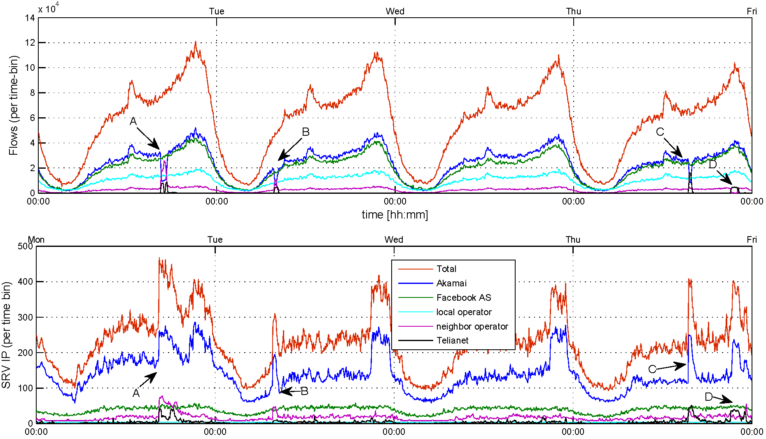

Akamai macroscopic traffic shifts [1/3] Time Series (4 days)
Events C and D
more details in next slide
flows
Events A and B
Traffic drop in Akamai AS (drop in number of served flows, active IPs)
Neighbor Operator 1 and Neighbor Operator 2 deploy back-up machines (increase number of active IPs) and together take over
A
B
C & D
srv IP
CDNs have ~constant share of deployed IPs and number of flows
Facebook AS and Akamai lead the number of served flows
Akamai employs largest share of active IPs per time-bin
Notes:
Non dire anomalie: PECULIAR EVENTS

Slide 11
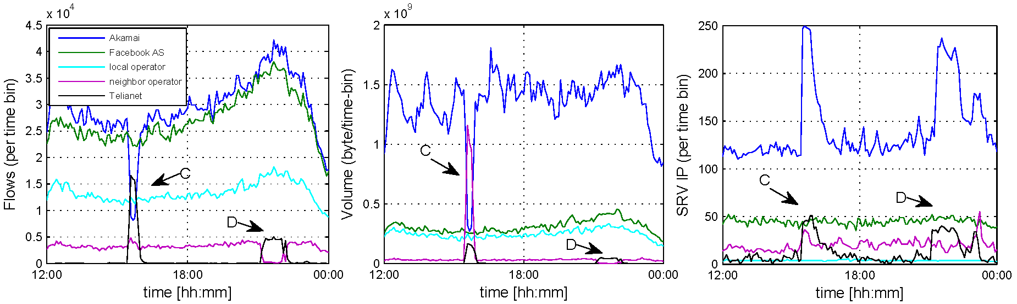
Akamai macroscopic traffic shifts [2/3] Time Series (12 hours zoom-in)
Zoom on last 12 hours:
Event C
Akamai: drop in number of flows, served volume but NOT active IPs
Neighbor Operator 2 increases number of active IPs, number of flows and volume
Neighbor Operator 1 keeps same number of active IPs, but increase served volume (takes over Akamai’s larger flows)
Event D
Akamai not involved
Swap between NO1 and NO2 w.r.t. number of flows
flows
volume
srv IP

Slide 12


Akamai macroscopic traffic shifts [3/3] Some considerations
Depending on the nature of commercial agreements for peering, it is possible that huge shifts of traffic volumes from one AS to another imply an economical loss for the ISP
Akamai
Neighbor Operator 1
Neighbor Operator 2
Events A-D reveal chain of agreements in serving contents
According to Akamai policies, it is possible that Akamai machines are installed in D.T. and TeliaNet networks (Akamai directly manages the shift)
No performance impact from user perspective (normal RTT, throughput, number of erroneous HTTP response codes)
But different commercial agreements for peering:
p2p
(free)
:(
c2p
($$$)
Local operator
Neighbor Operator 2
AS
AS
Akamai
AS
Neighbor Operator 1
c2p
($$$)
AS
Topology from: http://irl.cs.ucla.edu/topology/

Slide 13
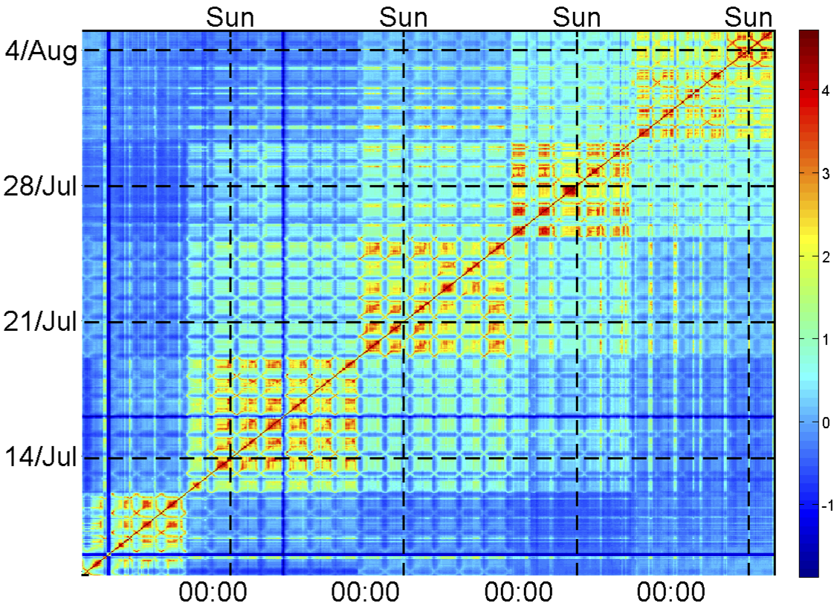

Temporal Similarity Plots (TSP) A powerfull tool to visualize temporal patterns
Discover temporal patterns and (ir)regularities in distribution timeseries
For every IP: counters of flows number and volume
Counters cumulated over different time scale (eg. 1hour)
For every time-bin: distribution of counters across IPs
Distribution compared with Kullback-Leibler metric
Comparisons plotted on heatmap (logscale)
Akamai IP addresses serving Facebook-related flows
uniform settings

Slide 14
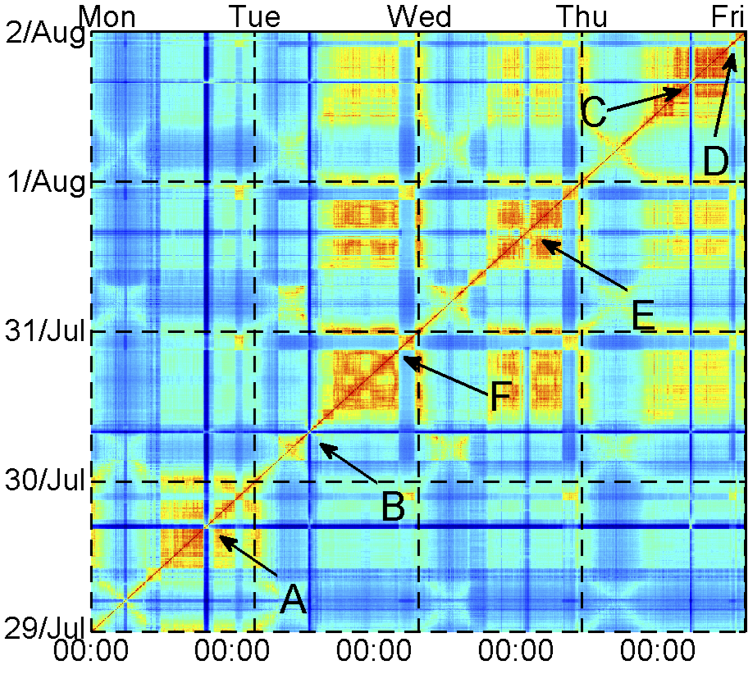
Temporal Similarity Plots (TSP) A powerfull tool to visualize temporal patterns
Zoom on unexpected events
Events A, B, C, D perfectly visible
Also new events (E, F) that were hidden in the time series

Slide 15
Outlook
Motivations
Monitoring setup and datasets
ADTool: an online Anomaly Detection tool
algorithm details
Use case 1: Akamai traffic shifts
Use case 2: Facebook outages
Use case 3: Youtube degradation of performances
Conclusions and Future Work

Slide 16
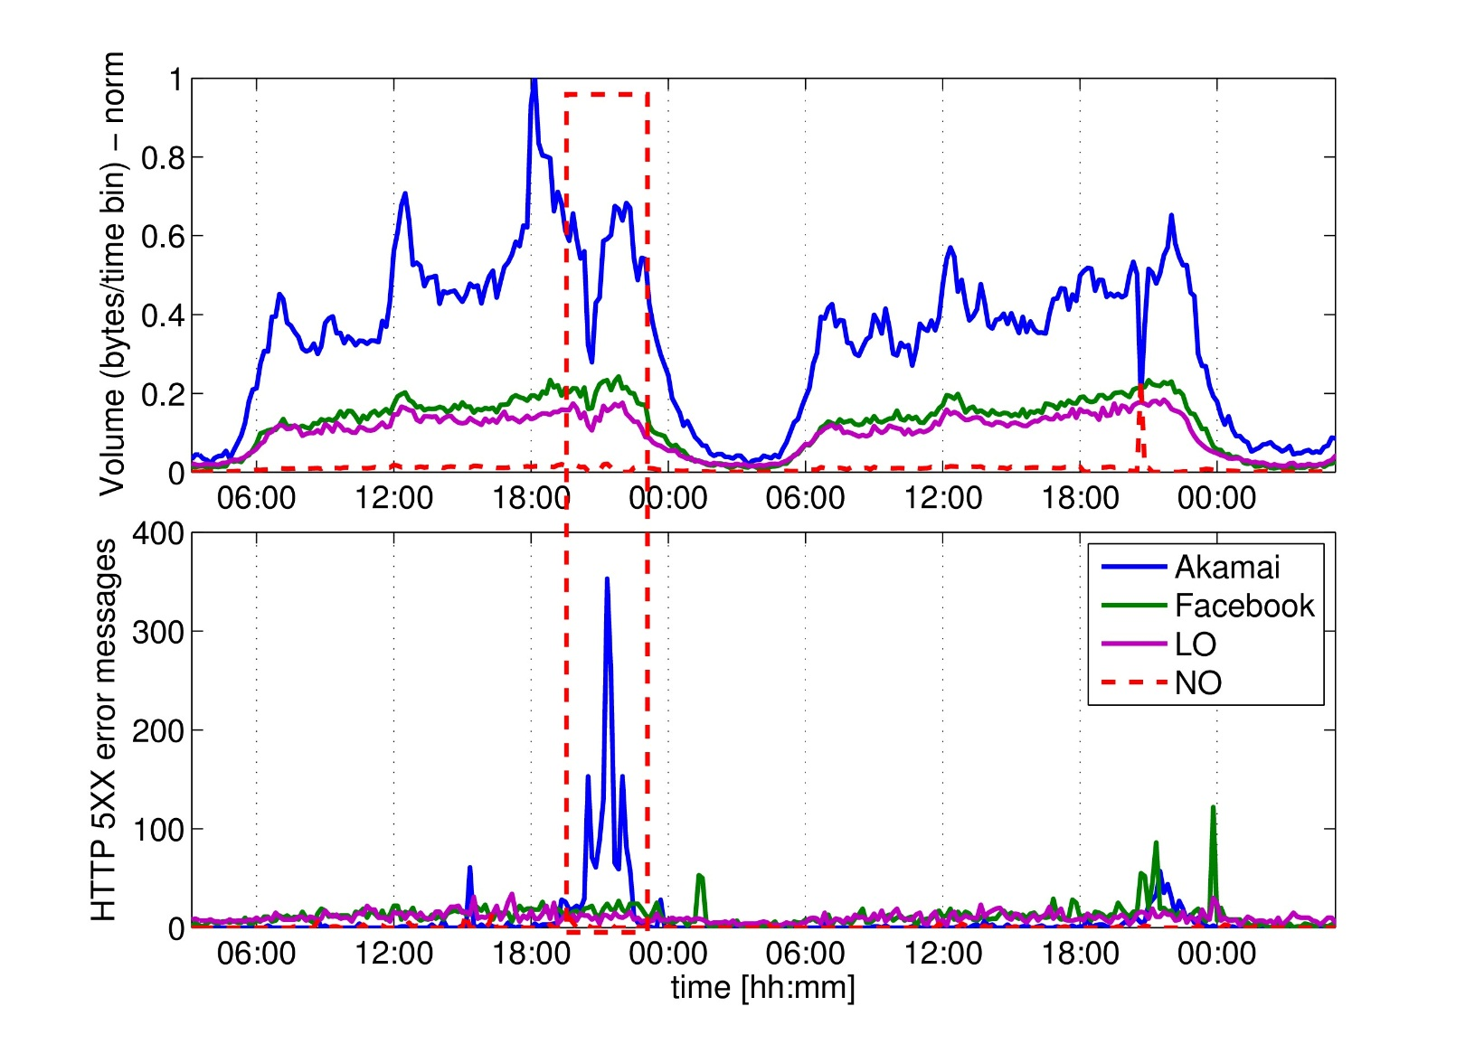
Facebook world-wide outage
Outages are typically not linked to CDN load-balancing policies
Nevertheless, they may involve different ASes provinding the service
Drop in Akamai‘s traffic volume
Other ASes do not take over
Increased number of 5XX server errors
Users experience service impairment

Slide 17
Outlook
Motivations
Monitoring setup and datasets
ADTool: an online Anomaly Detection tool
algorithm details
Use case 1: Akamai traffic shifts
Use case 2: Facebook outages
Use case 3: Youtube degradation of performances
Conclusions and Future Work

Slide 18

Youtube degradation of performance Load balancing gone bad
Requestes served by different /24 subnets
..which correspond to different data centers
Measurements from a single vantage point (European fixed-line ISP)
 |  | 5-May |  | 6-May |  | 7-May |  | 8-May |  | 9-May |  | 10-May
SUBNET | NAME with AIRPORT code | #flow | Tru avg | #flow | Tru avg | #flow | Tru avg | #flow | Tru avg | #flow | Tru avg | #flow | Tru avg
173.194.18 | fra02s08.c.youtube.com | -1 | -1 | -1 | -1 | -1 | -1 | 6139 | 368.93 | 6266 | 298.4 | 5389 | 228.76
173.194.19 | fra02s15.c.youtube.com | -1 | -1 | -1 | -1 | -1 | -1 | 9940 | 258.18 | 12893 | 196.06 | 7012 | 166.48
173.194.2 | mil01s12.c.youtube.com | 17054 | 1333.46 | 15470 | 1276.31 | 13655 | 1259.63 | 14186 | 1296.07 | 12616 | 1197.64 | 13860 | 1338.63
173.194.20 | par08s06.c.youtube.com | -1 | -1 | -1 | -1 | -1 | -1 | -1 | -1 | -1 | -1 | -1 | -1
173.194.208 | par08s06.c.youtube.com | -1 | -1 | -1 | -1 | -1 | -1 | -1 | -1 | 487 | 414.63 | 71 | 711.54
173.194.5 | lhr14s08.c.youtube.com | 449 | 1819.57 | 283 | 1658.45 | -1 | -1 | 3470 | 937.18 | 4222 | 1025.49 | 6191 | 1166.08
173.194.6 | fra07s13.c.youtube.com | -1 | -1 | -1 | -1 | -1 | -1 | 4924 | 412.17 | 8749 | 331.14 | 7224 | 318.83
173.194.62 | fra07s19.c.youtube.com | -1 | -1 | -1 | -1 | -1 | -1 | 6160 | 325.82 | 6877 | 248.39 | 6108 | 274.55
173.194.9 | par03s06.c.youtube.com | -1 | -1 | -1 | -1 | -1 | -1 | -1 | -1 | 87 | 355.1 | -1 | -1
208.117.236 | par03x04.c.youtube.com | 179 | 164.18 | 4250 | 540.16 | 957 | 496.91 | -1 | -1 | -1 | -1 | -1 | -1
208.117.248 | mia02s11.c.youtube.com | -1 | -1 | 77 | 552 | -1 | -1 | -1 | -1 | -1 | -1 | -1 | -1
208.117.250 | ams09x06.c.youtube.com | 41430 | 679 | 49437 | 656.39 | 57675 | 653.81 | 567 | 906.65 | -1 | -1 | -1 | -1
208.117.252 | dfw06x02.c.youtube.com | -1 | -1 | 51 | 285.63 | -1 | -1 | -1 | -1 | -1 | -1 | -1 | -1
208.117.254 | fra07x03.c.youtube.com | 838 | 667.29 | 2130 | 852.53 | -1 | -1 | 465 | 606.1 | 126 | 1146.87 | 1033 | 1379.76
74.125.105 | lhr22s16.c.youtube.com | 1829 | 1551.78 | 1655 | 1185.94 | 3957 | 942.47 | 3454 | 990.64 | 4116 | 1061.72 | 7657 | 1126.83
74.125.13 | zrh04s03.c.youtube.com | 719 | 1074.15 | 499 | 2264.09 | 82 | 1302.03 | -1 | -1 | -1 | -1 | -1 | -1
74.125.14 | mil02s01.c.youtube.com | 48366 | 1234.82 | 37968 | 1253.01 | 37182 | 1162.85 | 47844 | 1298.45 | 52594 | 1226.85 | 37755 | 1143.37
74.125.216 | bru02t11.c.youtube.com | -1 | -1 | -1 | -1 | -1 | -1 | -1 | -1 | -1 | -1 | -1 | -1
74.125.218 | fra07t13.c.youtube.com | 8697 | 1355.33 | 12579 | 1338.71 | 8560 | 1239 | 11469 | 1256.32 | 11633 | 1292.58 | 10320 | 1276.33
74.125.4 | lhr22s11.c.youtube.com | 1496 | 1846.25 | 2488 | 1034.78 | 4146 | 1363.63 | -1 | -1 | -1 | -1 | -1 | -1
74.125.99 | fra07s03.c.youtube.com | -1 | -1 | -1 | -1 | -1 | -1 | 4221 | 187.84 | 4913 | 189.64 | 2461 | 136.63

Slide 19
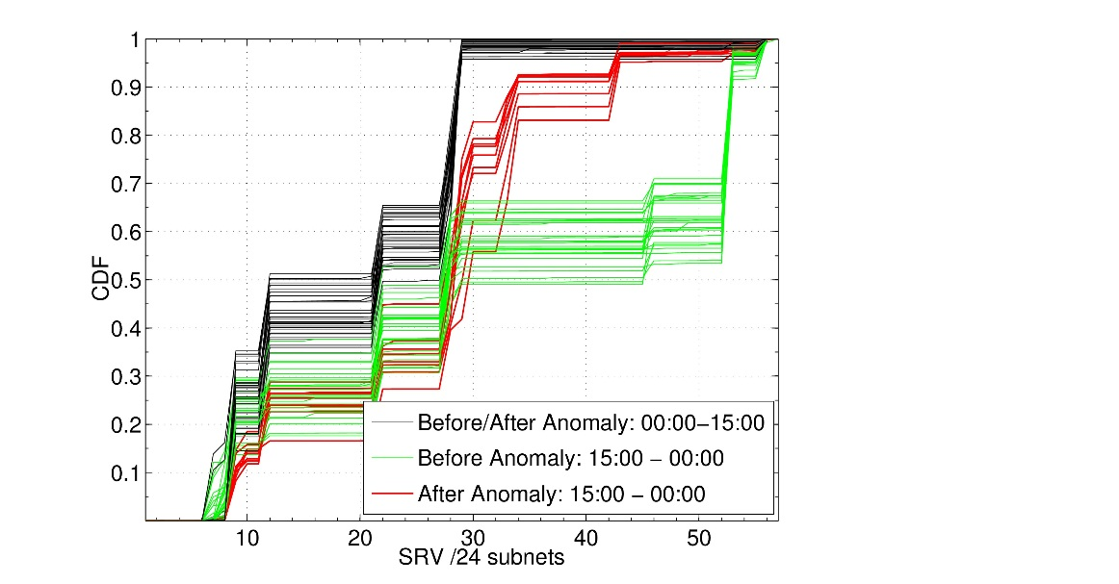
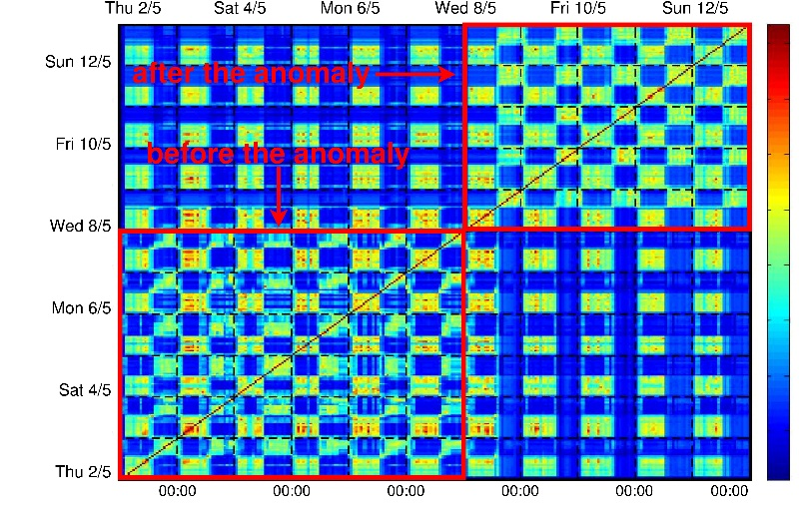
Youtube degradation of performance Load balancing gone bad, a further look
Sharp shift from AS15169 to AS 43515 during peak hours
Reduction of servers selected from AS43515 on the days of the anomlay
traffic distribution among /24 subnets
A different server selection policy has been set up
after this break point
Temporal Similarity Plot (TSP)

Slide 20
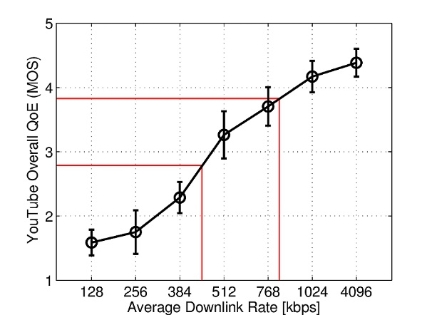
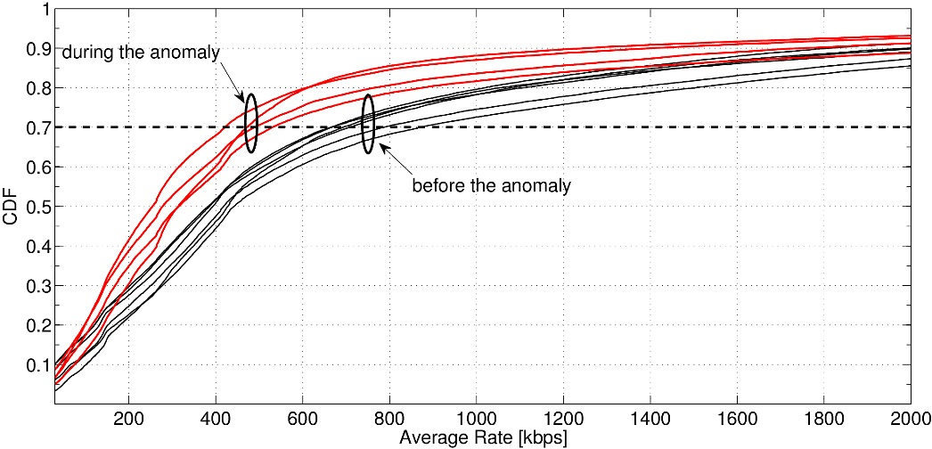
Youtube degradation of performance Decrease of average downlink rate (and QoE!)
Google‘s cache selection policies might be sub-optimal!
Let‘s consider a average downlink rate as main KPI:
Before: 70% of flows at ~800Kbps
After: 70% of flows at ~448Kbps
MOS = Mean Opinion Score
(1-month field trial, 40 users)
CDFs at peak hours (9pm – 11pm)
before and after change in cache selection policy
Avg. Downlink Rate and QoE
Loss of 1 point (MOS from 4 to 3) in Quality of Experience
customers noticed and complained with the operator

Slide 21
Outlook
Motivations
Monitoring setup and datasets
ADTool: an online Anomaly Detection tool
algorithm details
Use case 1: Akamai traffic shifts
Use case 2: Facebook outages
Use case 3: Youtube degradation of performances
Final remarks

Slide 22

Concluding remarks
Detection of macro-changes of CDN traffic patterns is valuable as it might impact costs for ISPs and quality for end-users
Tailor AD-System to different purposes
Cost optimization for operators (eg. Facebook use-case)
End-user perceived quality (eg. Youtube use-case)
Lesson learned:
Dynamic scenario: no once-and-forever learning
Long observation windows to fit multiple legitimate CDN configurations
Dynamically update notion of normality

Slide 23
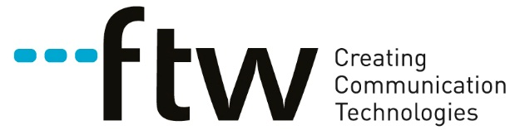

http://www.ftw.at
http://www.ict-mplane.eu
http://www.tuwien.ac.at
thank you for your attention!
Pierdomenico Fiadino
Telecommunications Research Center of Vienna (FTW)
<fiadino@ftw.at>

Slide 24
backup slides...

Slide 25
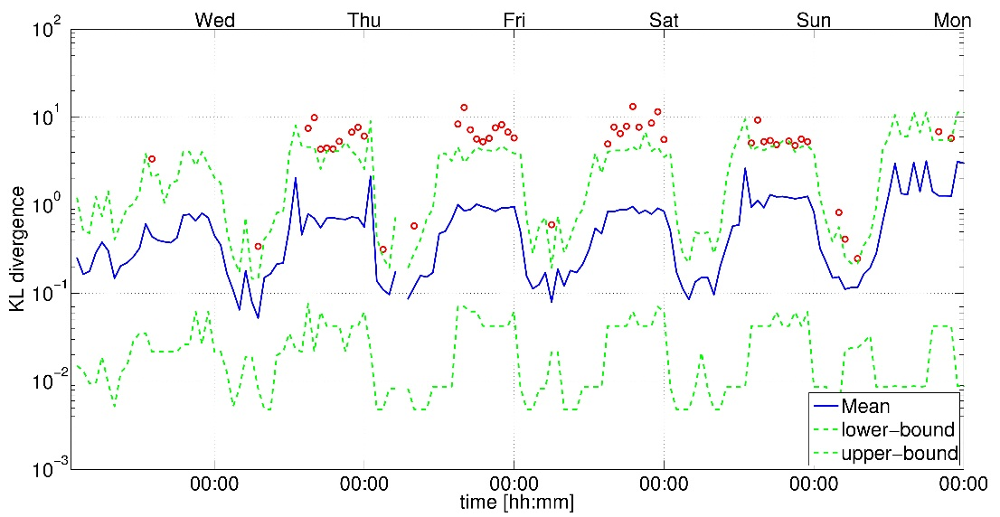
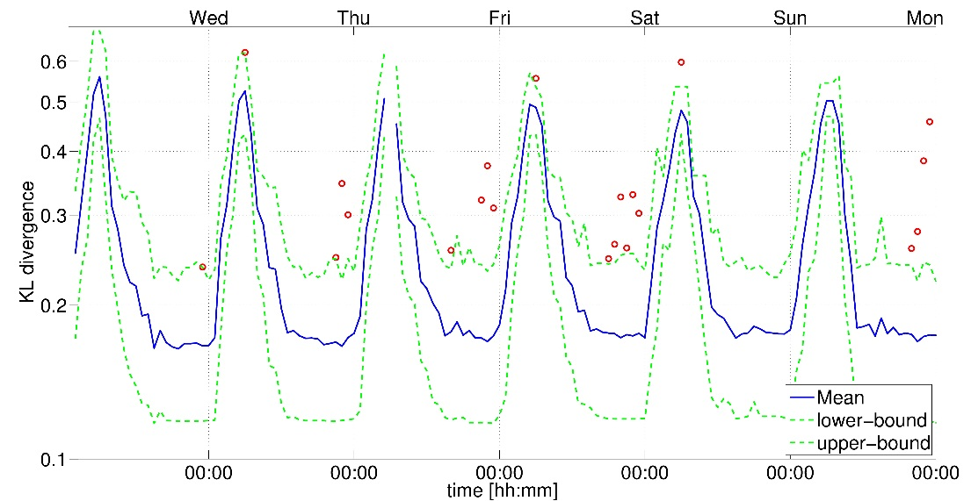
Youtube degradation of performance ADTool alarms
Alarms in traffic volume distribution across /24 subnets
Alarms in the distribution of AVG download throughput across users

Slide 26
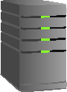

A typical CDN architecture Google CDN for Youtube
Google CDN employes a complex server selection strategy for:
load balancing
optimize client-server latency
increase QoE in general
DNS used for re-direction based on content popularity and location.
CDN Network
Local
DNS
Youtube
FEs
upstream
AS path
Ingress
Router
Front-end (FE)
(1) Client requests video to FE
(3) Client resolves content server name
(2) FE replies with content server name
client
Content
Servers
downstream
AS path
Egress
Router
(4) Client requests content
client
LatLong: Diagnosing Wide-Area Latency Changes for CDNs
Network and Service Management, IEEE Transactions on (Volume:9 , Issue: 3 )
Yaping Zhu et al.

Slide 27
Anomaly Detection and Diagnosis in CDN services
Examples of the types of problems we are targeting:
Bandwidth-sensitive services (YouTube) → downlink throughput degradation
Delay-sensitive services (Interactive Video, Gaming, etc.) → large latency increases/variations
Services outages → HTTP 5XX error messages increasing
Why mPlane? → the complexity of the CDN scenario and the number of intermediate actors involved in the E2E delivery.
Let’s consider YouTube as the main driving example.
Why users are having bad QoE? → why YT flows throughput drops to user sensitivity regions (throughout → QoE models)
Or who to blame? (the CDN, the ISPs, the inter-domain routing, etc.)

Slide 28
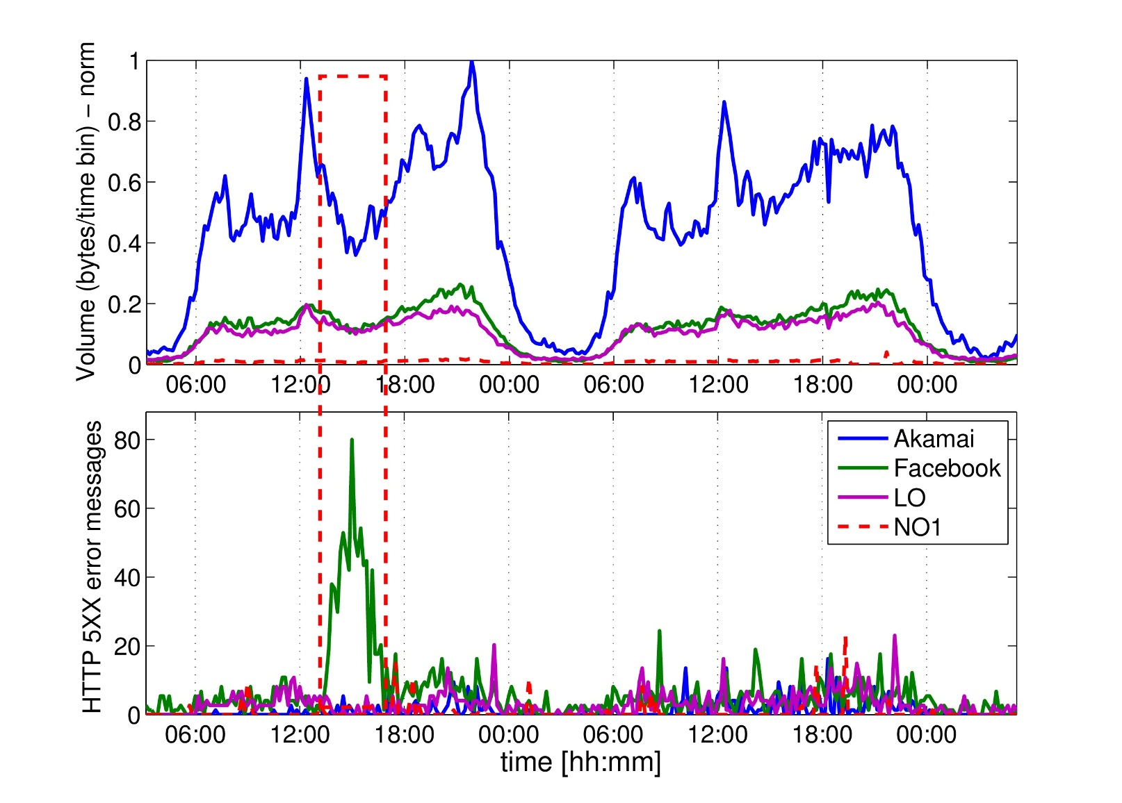
Facebook outage October 2013
Similar outages after exactly 1 month
Officialy reported by Facebook
Same outage characterisics as before

Slide 29
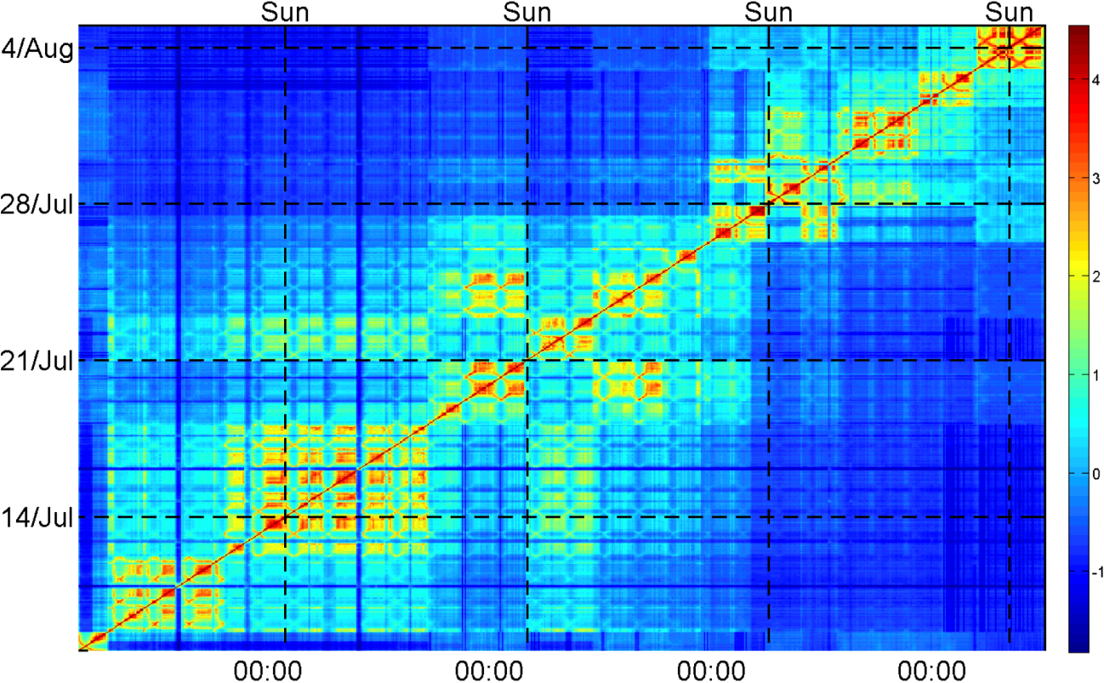
Temporal Similarity Plots (TSP) A powerfull tool to visualize temporal patterns
Discover temporal patterns and (ir)regularities in distribution timeseries
For every IP: counters of flows number and volume
Counters cumulated over different time scale (eg. 1hour)
For every time-bin: distribution of counters across IPs
Distribution compared with Kullback-Leibler metric
Comparisons plotted on heatmap (logscale)
uniform settings
Plotting different ASes separately in the next slides...

Slide 30
Temporal Similarity Plots (TSP) A.S. breakdown (Akamai)
Events A, B, C, D perfectly visible
Also new events (E, F) that were hidden in the time series
“Torture the data long enough and they will confess everything”

